Slide 1

ACA: Moving Forward Wednesday, August 24, 2016 12-1pm CDT Presenter: Phil Johnston Program Level: Basic
Copyright © 2016

Slide 2
Employers must notify employees: • Of Health Coverage Offer (when they become eligible) • Warn of Coverage Expiration (when no longer eligible) • Keep records of notifications made
Copyright © 2016

Slide 3
Employers must notify employees: • Of Health Coverage Offer (when they become eligible) • Warn of Coverage Expiration (when no longer eligible) • Keep records of notifications made This session will show you how to use Dashboard gadgets and ActivtyHD™ Automation features to help meet these needs.
Copyright © 2016

Slide 4
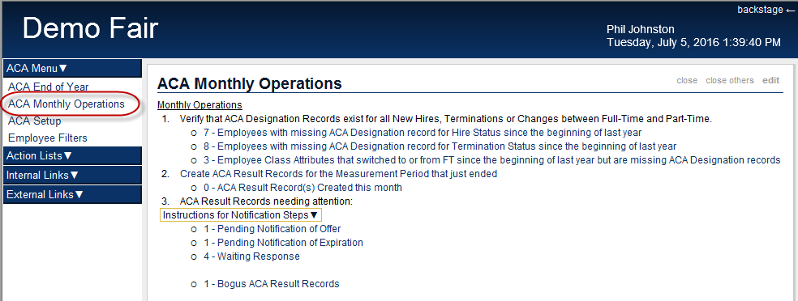
Copyright © 2016

Slide 5
The “ACA Monthly Operation” dashboard gadget includes three main steps: 1. Verify that the required ACA Designation Records exist 2. Create ACA Result Records based on the last completed measurement period 3. Follow up as needed based on Result Records and employee response
Copyright © 2016

Slide 6
Let’s see it in action!
Copyright © 2016

Slide 7
Contact Information
If you need assistance implementing ACA Dashboard Gadgets contact the nQativ support team at support@nqativ.com.
If you would like a quote for adding the ACA Dashboards, please contact Tim Evans at tevans@nqativ.com.
Tel: (806) 687-8500, (800) 354-7152 Fax: (806) 687-8511
Website: www.nqativ.com
Copyright © 2016

